Slide 1
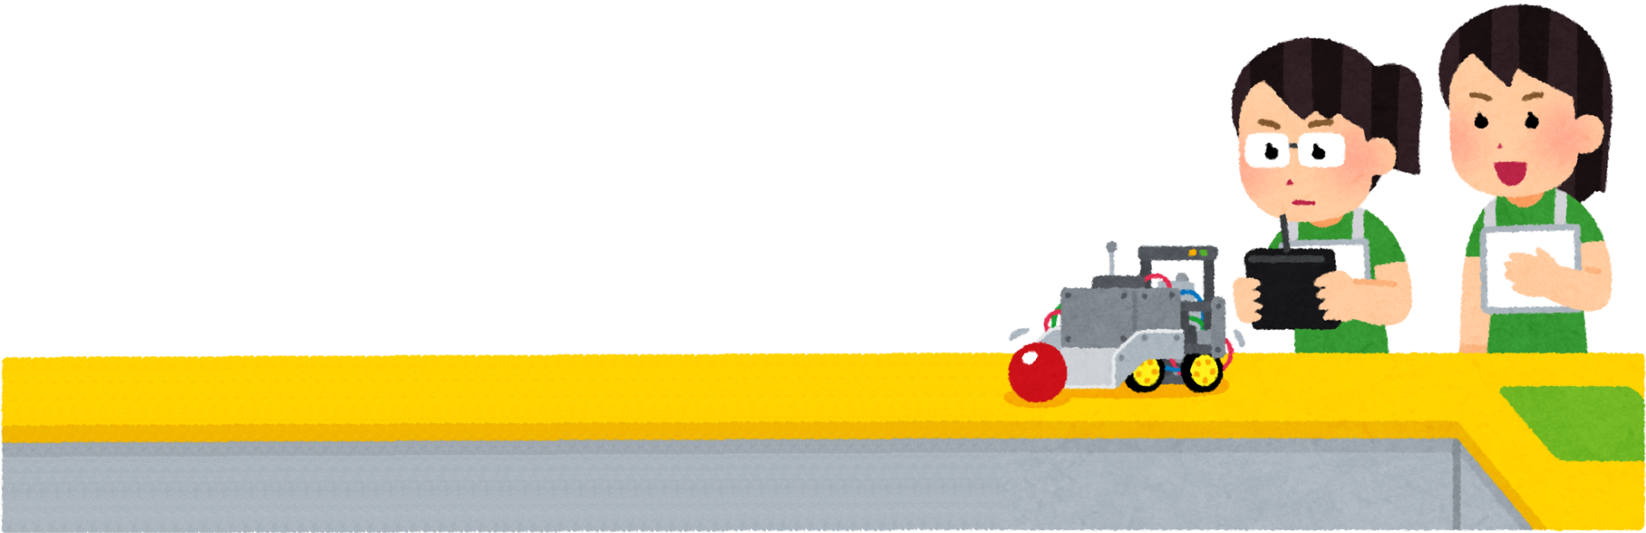
Digital Twin Dashboard with Real-Time Robot Telemetry
DevOps for Cyber-Physical Systems | University of Bern
Team Members
Alessandra Gorini
Tom Marti
Antonio Aparicio
Andrew Mullen
Anouk Martinez
Felix Merz
Supervised by:
Prakash Aryan

Slide 2

Motivation and Problem
Autonomous Robots not transparent enough
Overview of all the things going on inside
Battery, Collision Alerts, Faulty values, Drifting
Via some kind of monitoring software on the web
But how does this work when multiple robots are in action?
We can’t watch all dashboards at once…

Slide 3
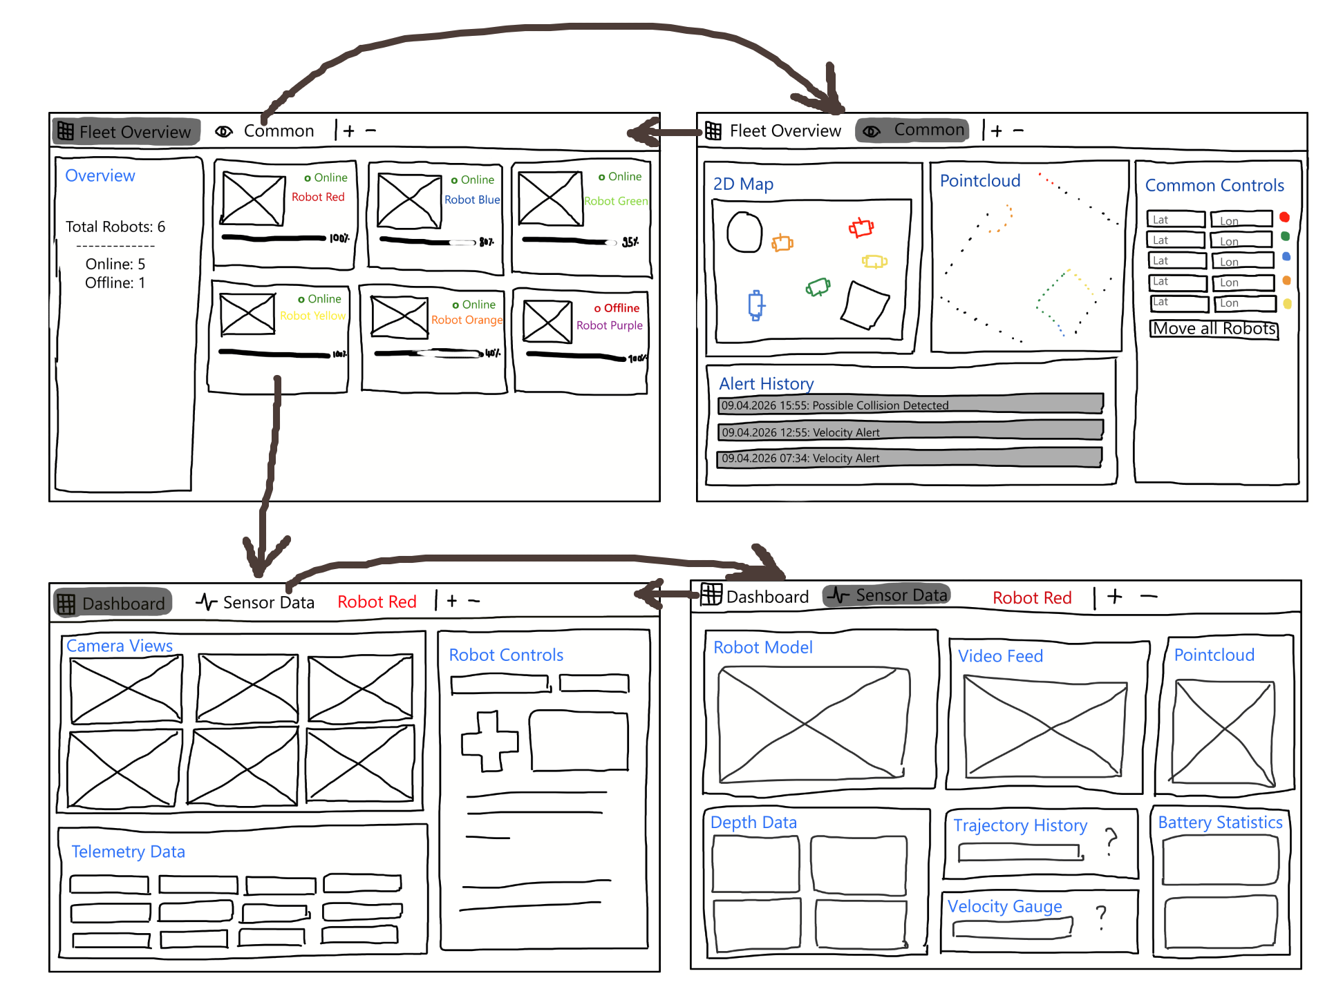
Goal
Centralized information source, easy to set up
Separate
Common information (Fleet Overview)
Robot specific information (Individual Dashboards)
Combine Robot Info when appropriate

Slide 4
Architecture and Techstack
Next.js Web/Desktop App
ROS 2/Simulation (Docker)
RosBridge Client
ROS Bridge
Ignition Gazebo Fortress
Panels (Grafana):
Video, Controls, Sensor Data, Map, Telemetry
Hooks:
useROS, useDR, useTF
TurtleBot3 Waffle
Websocket
ros_gz_bridge
rosbridge_suite
robot_state_publisher
DashboardClient
image_compressor

Slide 5
DEMO

Slide 6
Limitations
Cross-robot panels on the Common tab (2d map)
Trajectory history sensor widget
Camera feed with object detection

Slide 7

Conclusion
Single centralized interface to watch a fleet telemetry
Not only monitoring, also robot control
Modular and easy to extend (add robot or sensors with a minimal setup)
Work in simulation, need to be tested on real bots

